Slide 1
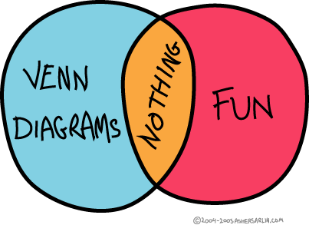
The art of being lucky
(probability in bridge)
Matthew Kidd, 2009
“Dans les champs
de l'observation le hasard ne favorise que les esprits préparés.”
- Louis Pasteur
“It’s better to be lucky than good.”
“Chance favors the prepared mind.”

Slide 2
Hoping for a 3-2 break
♠432
♠J87 ♠T9
♠AKQ65
(3-2 break)
♠432
♠J987 ♠T
♠AKQ65
(4-1 break)

Slide 3
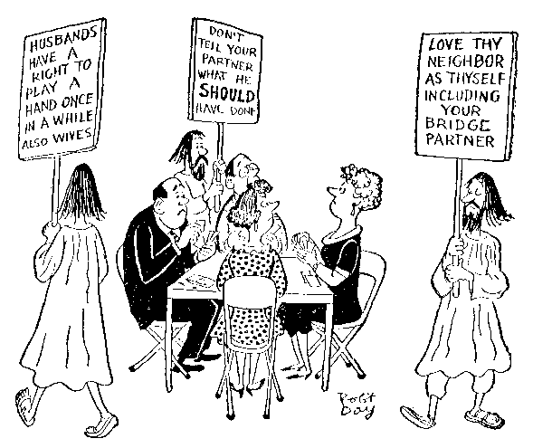



What does a “3-2” break mean?
Most of the time a 3-2 break means either
3-2 (LHO has 3, RHO has 2) or
2-3 (LHO has 2, RHO has 3).
Sometimes it means exactly the case where LHO has 3 cards and RHO has 2 cards.
Usually it is clear which, but not always (ask if confused).
CHO
Center
Handed
Opponent
LHO
Left
Handed
Opponent
RHO
Right
Handed
Opponent
You

Slide 4
The Wrong Way*
N choose K
Possible card combinations for one opponent Count
- (void) 1 = (5,0) → 3.125 %
J, T, 9, 8, 7 5 = (5,1) → 15.625 %
JT, J9, J8, J7, T9, T8, T7, 98, 97, 87 10 = (5,2) → 31.250 %
JT9, JT8, JT7, J98, J97, J87, T98, T97, T87, 987 10 = (5,3) → 31.250 %
JT98, JT97, JT87, J987, T987 5 = (5,4) → 15.625 %
JT987 1 = (5,5) → 3.125 %
32
Odds of 3-2 break would seem
to be 2 x 31.25% = 62.5%
1 1
1 2 1
1 3 3 1
1 4 6 4 1
1 5 10 10 5 1
Remember Pascal’s Triangle?
*but not horribly wrong

Slide 5
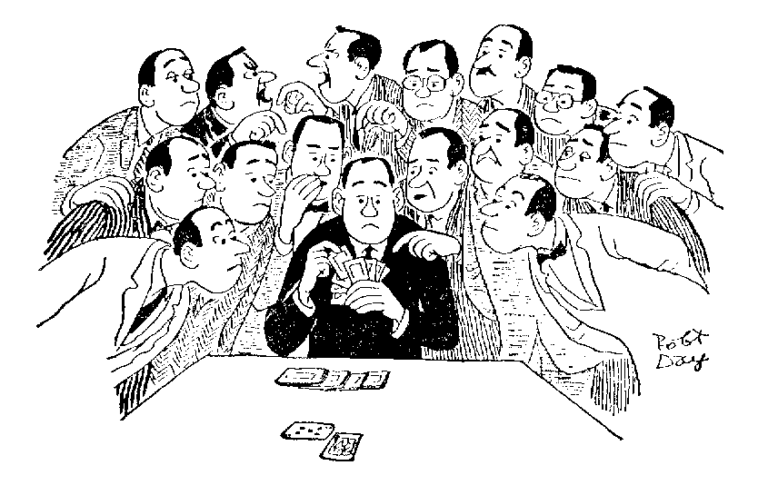
What’s wrong?
We are not merely flipping coins!
There are cards in the other
suits, “spectator cards”.
Probability of holding a specific 2 or 3 card combination (e.g. JT or T87) >
Probability of holding a specific 1 or 4 card combination (e.g. T987 or 8) >
Probability of holding 0 or all 5 cards.

Slide 6
The Correct Way
The opponents hold 5 trump and 21 other cards (2 x 13 – 5).
Total number of LHO/RHO layouts is (26,13)
P(LHO has 3 trump) = (5,3) * (21,10) / (26,13)
= 33.91 %
Lesson: Odds of 3-2 break are actually 2 x 33.91 = 67.8% (5.3% higher)

Slide 7

Comparison of methods
LHO: 5
RHO: 0
Lesson: The Bridge Gods smile more often than they frown.

Slide 8
Split probabilities for 2-7 outstanding cards
For even number of outstanding cards, second most favorable split is most likely (except for 2 cards).
For odd number of outstanding cards, most favorable split is most likely.

Slide 9
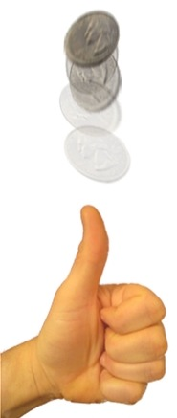
The finesse
(a 50-50 proposition)
♥AQ
♥K… ♥…
♥xx
(onside K)
♥AQ
♥… ♥K…
♥xx
(offside K)
Vocabulary: declarer finesses the queen, finessing against the king.

Slide 10
The double finesse
♥AQT
♥KJ… ♥…
♥xxx
(both onside)
♥AQT
♥K… ♥J…
♥xxx
(J offside)
3 tricks – 25%
2 tricks – 50%
1 trick – 25%
♥AQT
♥… ♥KJ…
♥xxx
(both offside)
♥AQT
♥J… ♥K…
♥xxx
(K offside)

Slide 11


Slide 12
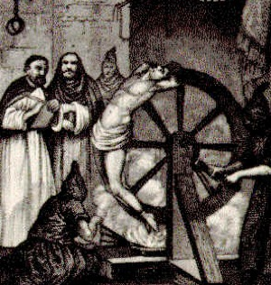
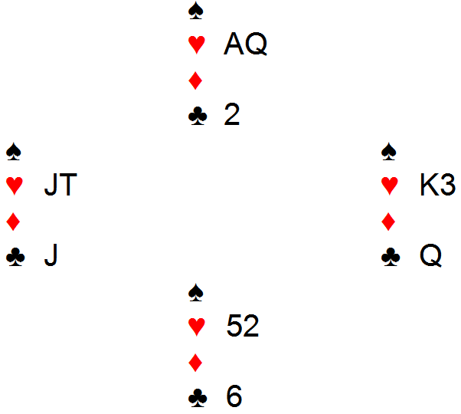
Improve your chances with an endplay!
Advanced
Topic!
Lead this!

Slide 13

Finesse or drop? (9-card fit)
♠KJ32
♠? ♠?
♠A7654
Play the ♠A and then either:
Lead to the ♠J
(playing for the finesse)
Lead to the ♠K
(playing for the drop)
Which line is best?
or

Slide 14
Drop works when suit is 2-2 or Q is singleton
♠KJ32
♠T8 ♠Q9
♠A7654
♠KJ32
♠T98 ♠Q
♠AJ654
♠KJ32
♠Q ♠T98
♠AJ654
24.9% x 1/4
24.9% x 1/4
40.7%
Total: 40.7% + 24.9% x ¼ + 24.9% x ¼ = 53.1%

Slide 15
Split probabilities for 2-7 outstanding cards
For even number of outstanding cards, second most favorable split is most likely (except for 2 cards).
For odd number of outstanding cards, most favorable split is most likely.

Slide 16
Finesse works when Q is onside & suit not 4-0
♠KJ32
♠Q ♠T98
♠A7654
♠KJ32
♠Qx ♠xx
♠A7654
♠KJ32
♠Qxx ♠x
♠A7654
♠KJ32
♠T98 ♠Q
♠A7654
24.9% x 1/4
40.7% x 1/2
24.9% x 3/4
24.9% x 1/4
Total: 40.7% + 24.9% x ¼ + 24.9% x ¼ = 51.5%
With a 9-card fit, the drop (53.1%) slightly beats the finesse (51.5%).

Slide 17
Finesse or drop? (8-card fit)
♠KJ2
♠? ♠?
♠A6543
Play the ♠A and then either:
Lead to the ♠K
(playing for the drop)
Lead to the ♠J
(playing for the finesse)
Which line is best?

Slide 18
Drop works when Q is doubleton or Q is singleton
♠KJ2
♠xxx ♠Qx
♠A6543
♠KJ2
♠Qx ♠xxx
♠A6543
♠KJ2
♠Q ♠T987
♠A6543
♠KJ2
♠T987 ♠Q
♠A6543
33.9% x 2/5
33.9% x 2/5
14.1% x 1/5
14.1% x 1/5
Total: 32.8%

Slide 19
Finesse works when Q is onside (3-2 split) or Q singleton
♠KJ2
♠Qxx ♠xx
♠A6543
♠KJ2
♠Qx ♠xxx
♠A6543
♠KJ2
♠Q ♠T987
♠A6543
♠KJ2
♠T987 ♠Q
♠A6543
33.9% x 3/5
33.9% x 2/5
14.1% x 1/5
14.1% x 1/5
Total: 41.0%
With an 8-card fit, the finesse (41.0%) significantly beats the drop (32.8%).

Slide 20
“8-Ever, 9-Never”
With an 8-card fit, the finesse (41.0%) significantly beats the drop (32.8%).
With a 9-card fit, the drop (53.1%) slightly beats the finesse (51.5%).
Q: Should you finesse? “Eight ever; nine never.”

Slide 21
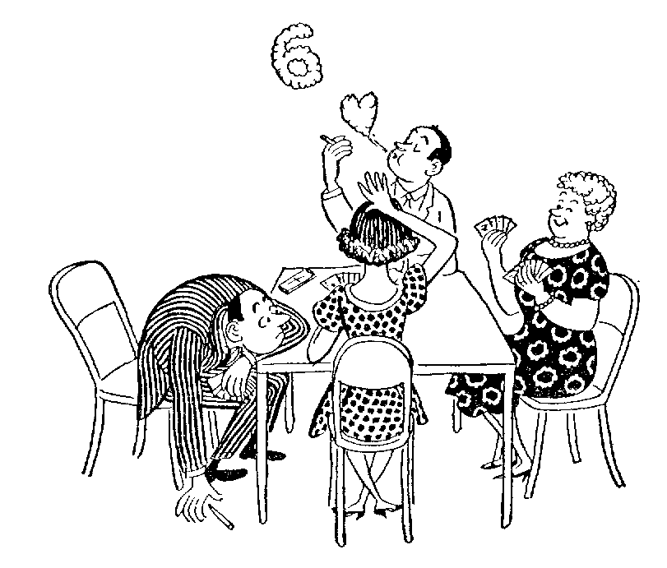
“A peek is worth 2 finesses”

Slide 22
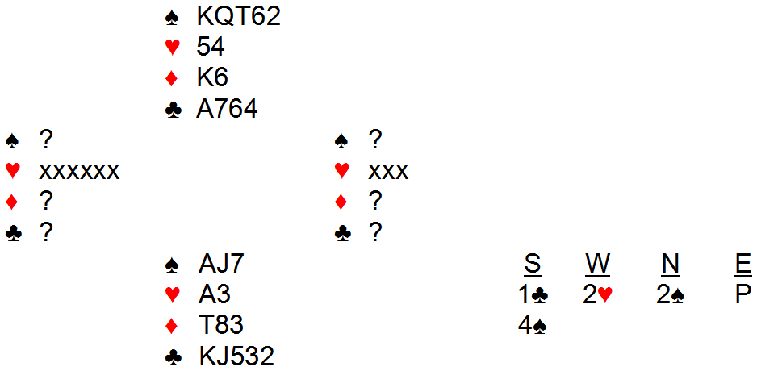
Conditional Probability
(or never say “never”)
Q: How to play clubs: drop or finesse?
“Weak Two” overcall: 6 hearts and a poor hand (5-11 hcp)

Slide 23
Without the 2♥ preempt
The opponents hold 4 trump and 22 other cards.
Total number of LHO/RHO layouts is (26,13)
P(LHO has 2 trump) = (4,2) * (22,11) / (26,13) = 40.7 %
With the 2♥ preempt
The opponents hold 4 trump, 9 hearts split 6-3, and 13 other cards.
Total number of LHO layouts is (9,6) * (17,7) =
(9,3) * (17,10) = Total number of RHO layouts
Remember: (9,6) = 9! / 6! (9-6)! = 9! / 6! 3! = 9! / (9-3)! 3! = (9,3); symmetric!
P(LHO has 2 trump | 6 hearts) =
(4,2) * (9,6) * (13,5) / (9,6) * (17,7) =
(4,2) * (13,5) / (17,7) = 39.7 %

Slide 24

Shifting Probability
Note: 2-2 split is still quite likely. Preempts do not reduce the chance of a favorable (trump) split nearly as much as intuition might suggest. This is generally true. Do not live in fear!

Slide 25
Recomputing the probability
♠A764
♠T98 ♠Q
♠KJ532
♠A764
♠xx ♠Qx
♠KJ532
♠A764
♠x ♠Qxx
♠KJ532
♠A764
♠Q ♠T98
♠KJ532
Finesse
total:
58.8%
14.7% x 1/4
39.7% x 1/2
35.3% x 3/4
35.3% x 1/4
♠A764
♠T8 ♠Q9
♠KJ532
♠A764
♠Q ♠T98
♠KJ532
♠A764
♠T98 ♠Q
♠KJ532
Drop
total:
52.2%
39.7%
35.3% x 1/4
14.7% x 1/4
Different result! Now finesse has a 6.6% edge.

Slide 26
Joint Probability
Say you need the following to make your contract:
Favorable 3-2 trump break.
At least two tricks from an AQT double finesse.
P(success) = 67.8% (3-2 break) * 75% (double finesse) = 50.9%
Warning: The above calculation is fairly accurate because #1 and #2 are nearly independent probabilities. In some cases there are significant correlations, e.g. a favorable break in one suit makes a favorable break in another more likely. In such cases, a more careful calculation must be made if accuracy is desired.

Slide 27
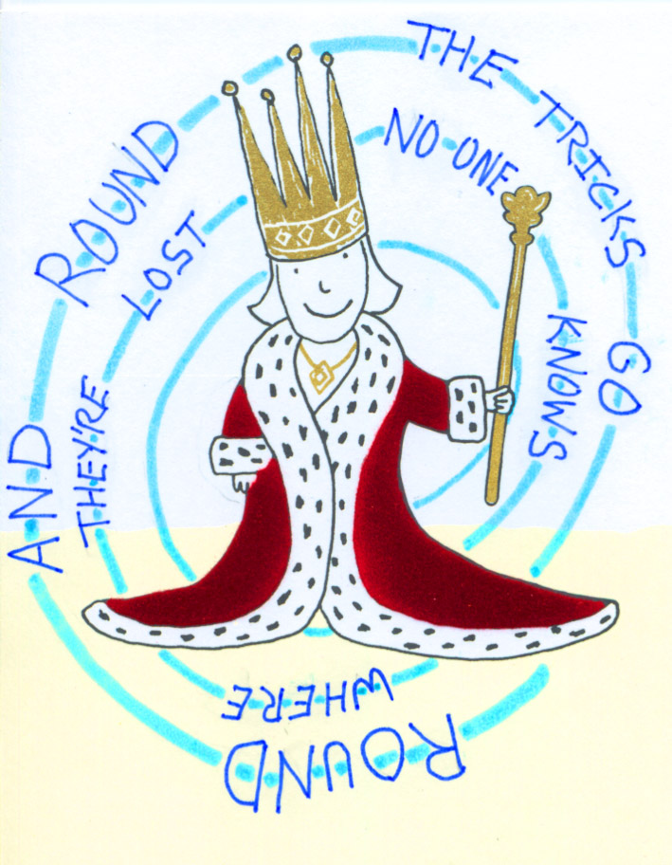
Do bridge players care about the odds?
Some don’t; the better ones do.
In most case it suffices to know the best line of play, not exactly how much better it is than the alternatives.
It is handy to know a few numbers (e.g. chances of 2-3 and 3-3 breaks).
Experience counts; good players have an instinctive feel based on encountering common situations many times.
Intuition is not always right (worried about flying? Try driving if you really want to risk death).
Proving partner or teammates wrong can be satisfying, even if it requires several hours of computation.

Slide 28
More on bridge probability
Bridge Odds for Practical Players (Hugh Kelsey)
Dictionary of Suit Combinations, J.M. Roudinesco
SuitPlay program

Slide 29
Selected Bridge Websites
American Contract Bridge League
http://www.acbl.org
La Jolla Unit
http://lajollabridge.com
Soledad Club (Mon Aft, Thu Eve games)
http://www.soledadclub.com/soledad-bridge-club.htm
Adventures in Bridge (games every day)
http://www.adventuresinbridge.com/

Slide 30
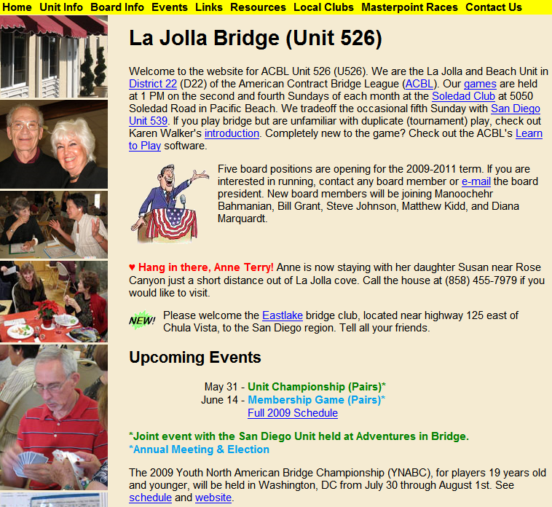

Slide 31
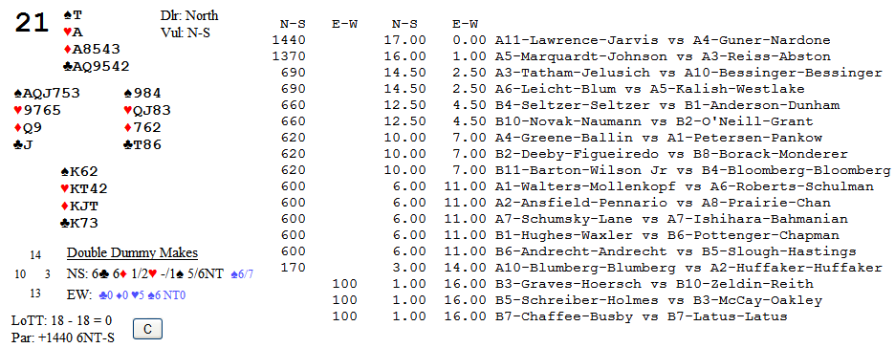
Example Matchpoint Result (Top = 17)
6N – best NS result
6♣/♦ – 2nd best NS result
3N+3
3N+2
5♣/♦+1
5♣/♦
4♣/♦+2

