Slide 1
IMPROVERS’ LESSONS Welcome
Teacher: Your Name Here
Telephone: 123 4567
Email: email@address.co.nz

Slide 2
Lesson Seven Signals and Discards

Slide 3
OPENING LEADS
The opening lead must be clear and unambiguous

Slide 4
OPENING LEADS AND LEADS DURING PLAY
Lead TOP of a sequence
When leading during play, keep to the same principles

Slide 5
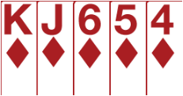
OPENING LEADS AND LEADS DURING PLAY
LOW card promises an honour
When leading during play, keep to the same principles

Slide 6
OPENING LEADS AND LEADS DURING PLAY
HIGH card (non-honour) denies an honour
When leading during play, keep to the same principles

Slide 7
SIGNALS DURING PLAY OF THE HAND
When a lead is made, tell partner if you like it

Slide 8
SIGNALS DURING PLAY OF THE HAND
LOW card – encouraging - you want the suit continued – shows an honour in the suit (or a shortage)
HIGH card – no help in the suit played

Slide 9
SIGNALS DURING PLAY
Encourage - low
Discourage - high
Partner leads ♥A
Which card do you play?

Slide 10
DISCARDS
Tell partner which suit you like
LOW card – honour in the suit (A, K or Q)
HIGH card – no honour in the suit

Slide 11
DISCARDS
Against a Notrump contract, try not to discard from your long suit
LOW card – honour in the suit (A, K or Q)
HIGH card – no honour in the suit

Slide 12
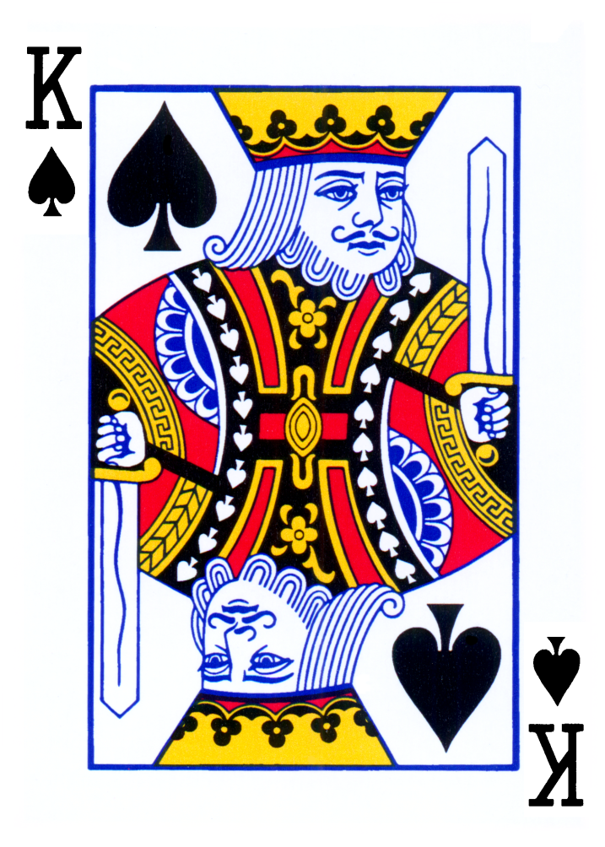
GENERAL PRINCIPLES
Lead of an honour – shows top of a sequence
These principles apply throughout the defence

Slide 13
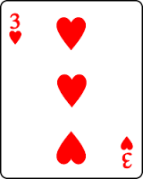
GENERAL PRINCIPLES
Lead or discard of a low card – shows at least one honour in that suit
These principles apply throughout the defence

Slide 14
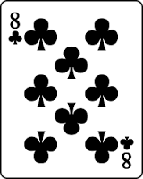
GENERAL PRINCIPLES
Lead or discard of a high card – shows no honour in that suit
These principles apply throughout the defence

Slide 15
IMPROVERS’ LESSONS
Please contact me if you have any questions
Teacher: Your Name Here
Telephone: 123 4567
Email: email@address.co.nz

